Slide 1
Chapter 10 Database Management

Slide 2
Chapter 10 Objectives
Define the term, database
Differentiate between a file processing system approach and the database approach
Identify the qualities of valuable information
Discuss the functions common to most DBMSs
Explain why data is important to an organization
Describe characteristics of relational, object-oriented, and multidimensional databases
Discuss the terms character, field, record, and file
Explain how to interact with Web databases
Identify file maintenance techniques
Discuss the responsibilities of database analysts and administrators
Next

Slide 3
Data and Information
What is a database?
Collection of data organized so you can access, retrieve, and use it
Database software allows you to
Database software also called database management system (DBMS)
Create database
Create forms and reports
Add, change, and delete data
Sort and retrieve data
p. 514 - 515
Next

Slide 4
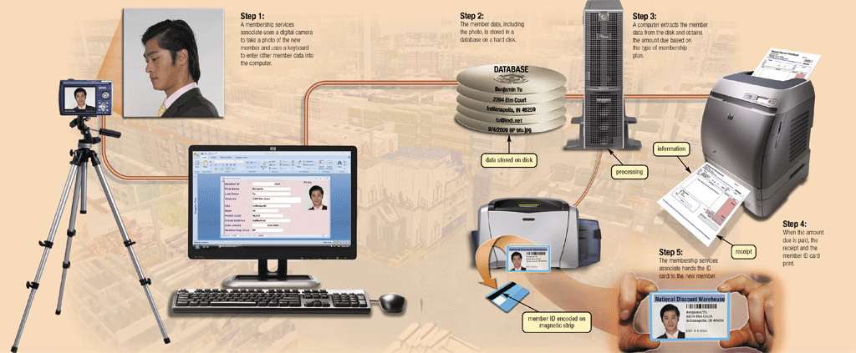
Data and Information
How are data and information related?
Data is a collection of unprocessed items
Information is data that is organized and meaningful
Computers process data into information
p. 514 - 515 Fig. 10-1
Next

Slide 5
Data and Information
What is data integrity?
Garbage in
Degree to which data is correct
Garbage in, garbage out (GIGO)—computer phrase that means you cannot create correct information from incorrect data
Garbage out
Data integrity is lost
Click to view Web Link, click Chapter 10, Click Web Link from left navigation, then click Data Security below Chapter 10
p. 516
Next

Slide 6
Data and Information
What are the qualities of valuable information?
Accurate
Verifiable
Timely
Organized
Accessible
Useful
Cost-effective
p. 516 - 517
Next

Slide 7
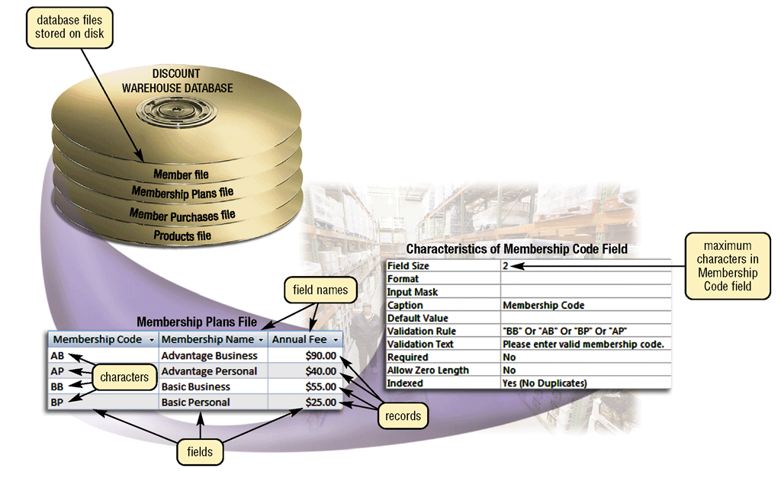
The Hierarchy of Data
What is a hierarchy?
Database contains files, file contains records, record contains fields, field contains characters
p. 517 Fig. 10-2
Next

Slide 8
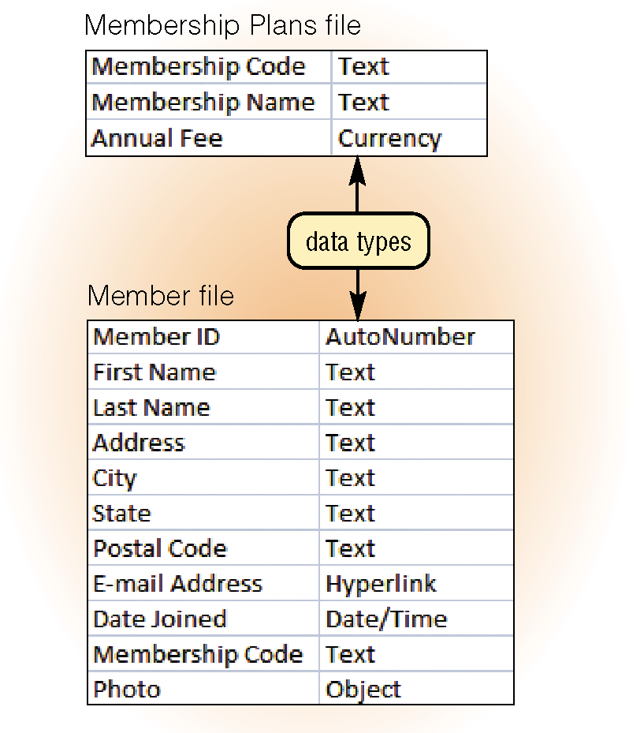
The Hierarchy of Data
What is a field?
Combination of one or more characters
Smallest unit of data user accesses
Field name uniquely identifies each field
Field size defines the maximum number of characters a field can contain
Data type specifies kind of data field contains
p. 518 Fig. 10-3
Next

Slide 9
The Hierarchy of Data
What are common data types?
Text
(also called alphanumeric)—letters, numbers, or special characters
Numeric
numbers only
AutoNumber
unique number automatically assigned to each new record
Currency
dollar and cent amounts or numbers containing decimal values
Date
month, day, year, and sometimes time
Memo
lengthy text entries
Object
(also called BLOB for binary large object)—photograph, audio, video, or document created in other application such as word processing or spreadsheet
Yes/No
(also called Boolean)—only the values Yes or No (or True or False)
Hyperlink
Web address that links to document or Web page
p. 518
Next

Slide 10
The Hierarchy of Data
What is a record?
Group of related fields
Key field, or primary key, uniquely identifies each record
p. 519
Next

Slide 11
The Hierarchy of Data
What is a data file?
Collection of related records stored on disk
p. 518
Next

Slide 12
Maintaining Data
What is file maintenance?
Procedures that keep data current
Adding records
Changing records
Deleting records
p. 520
Next

Slide 13
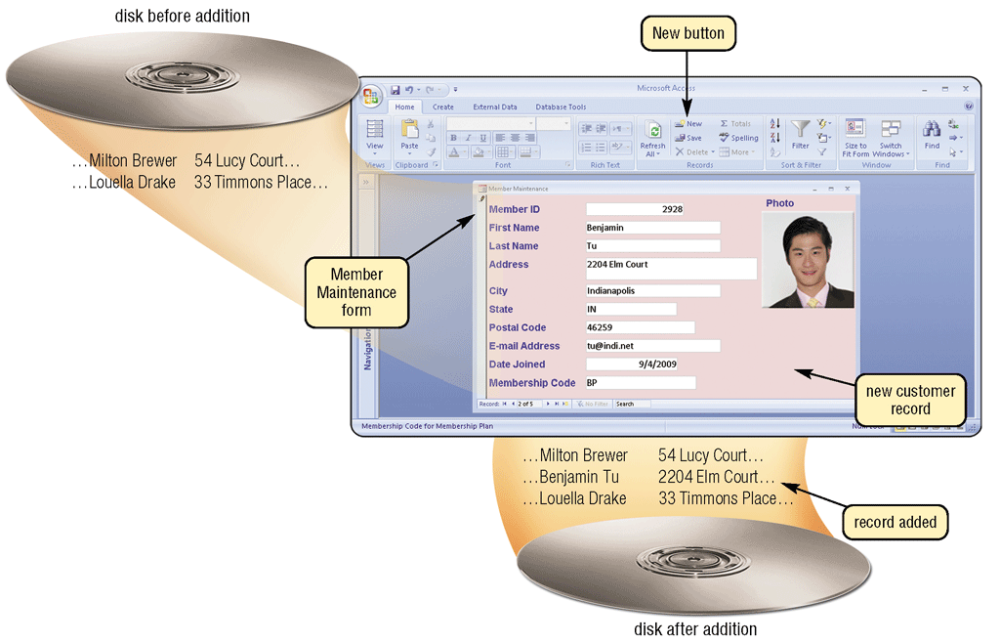
Maintaining Data
Why do you add records?
Add new record when you obtain new data
p. 520 Fig. 10-5
Next

Slide 14
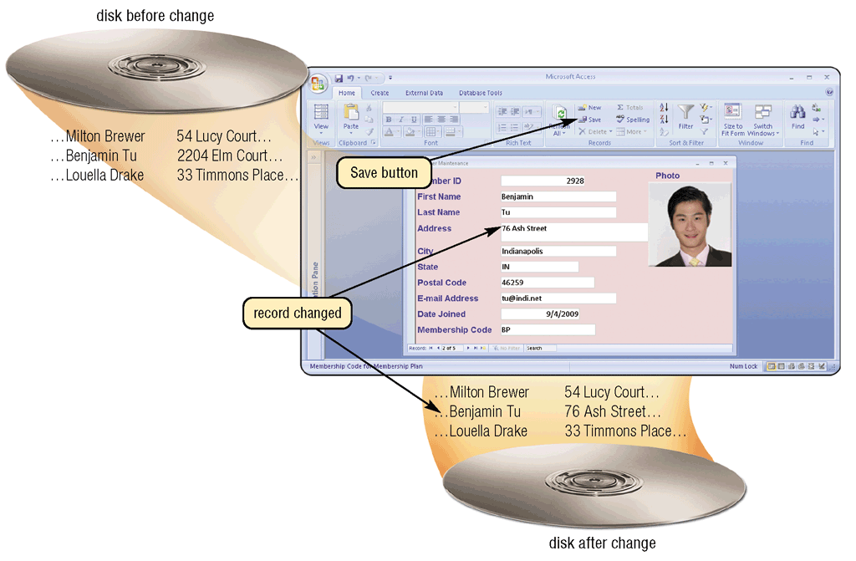
Maintaining Data
Why do you change records?
Correct inaccurate data
Update old data
p. 521 Fig. 10-6
Next

Slide 15
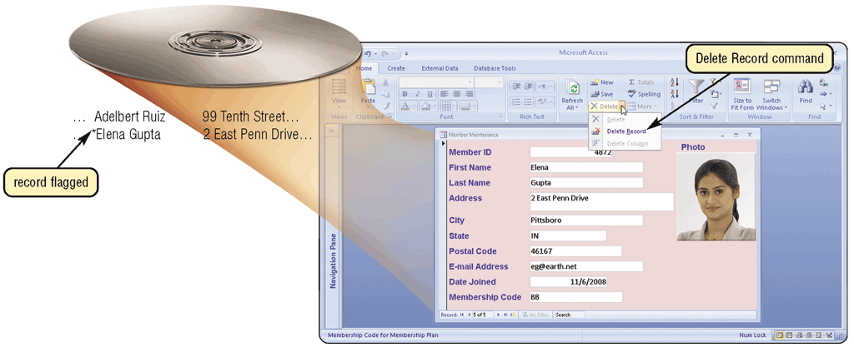
Maintaining Data
Why do you delete records?
When record no longer is needed
Some programs remove record immediately, others flag record
p. 522 Fig. 10-7
Next

Slide 16
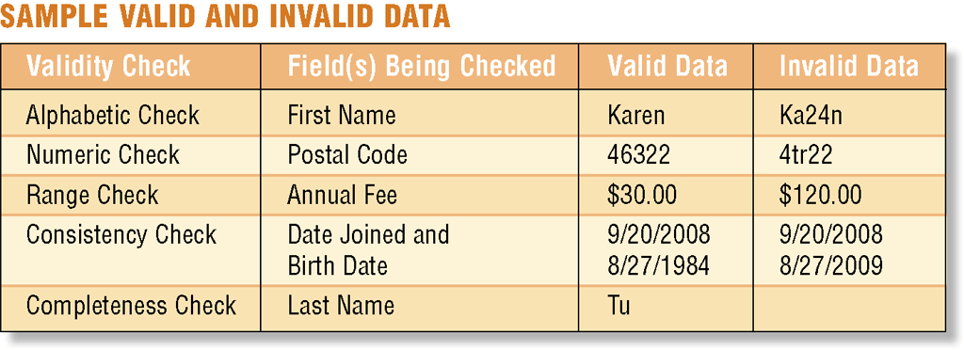
Maintaining Data
What is validation?
Process of comparing data with a set of rules to find out if data is correct
Reduce data entry errors and enhance data integrity before program writes data on disk
p. 522 - 523 Fig. 10-8
Next

Slide 17
Maintaining Data
What are the types of validity checks?
Check Digit number(s) or character(s) appended to or inserted into a primary key value to confirm accuracy of primary key value
Alphabetic/ Numeric Check ensures correct type of data entered
Completeness Check verifies that a required field contains data
Range Check determines whether number is within specified range
Consistency Check tests for logical relationship between two or more fields
p. 523
Next

Slide 18
File Processing Versus Databases
What is a file processing system?
Each department or area within organization has own set of files
Records in one file may not relate to records in any other file
May have weaknesses
Data redundancy—same fields stored in multiple files
Isolated data—data stored in separate files so it is difficult to access
p. 524
Next

Slide 19
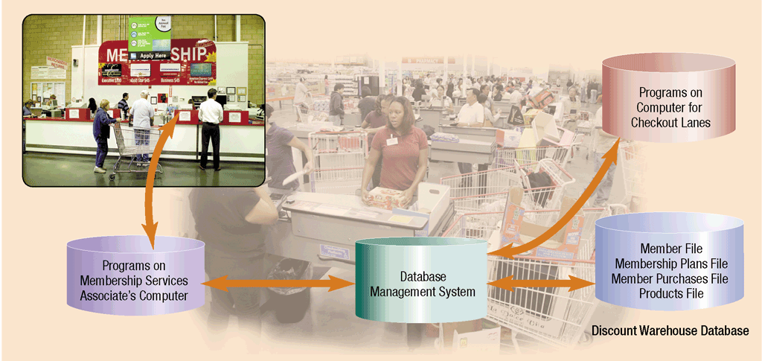
File Processing Versus Databases
What is the database approach?
Many programs and users can share data in database
Secures data so only authorized users can access certain data
p. 524 - 525 Fig. 10-9
Next

Slide 20
File Processing Versus Databases
What are the strengths of the database approach?
Reduced data redundancy
Improved data integrity
Shared
data
Easier access
Reduced development time
p. 525
Next

Slide 21
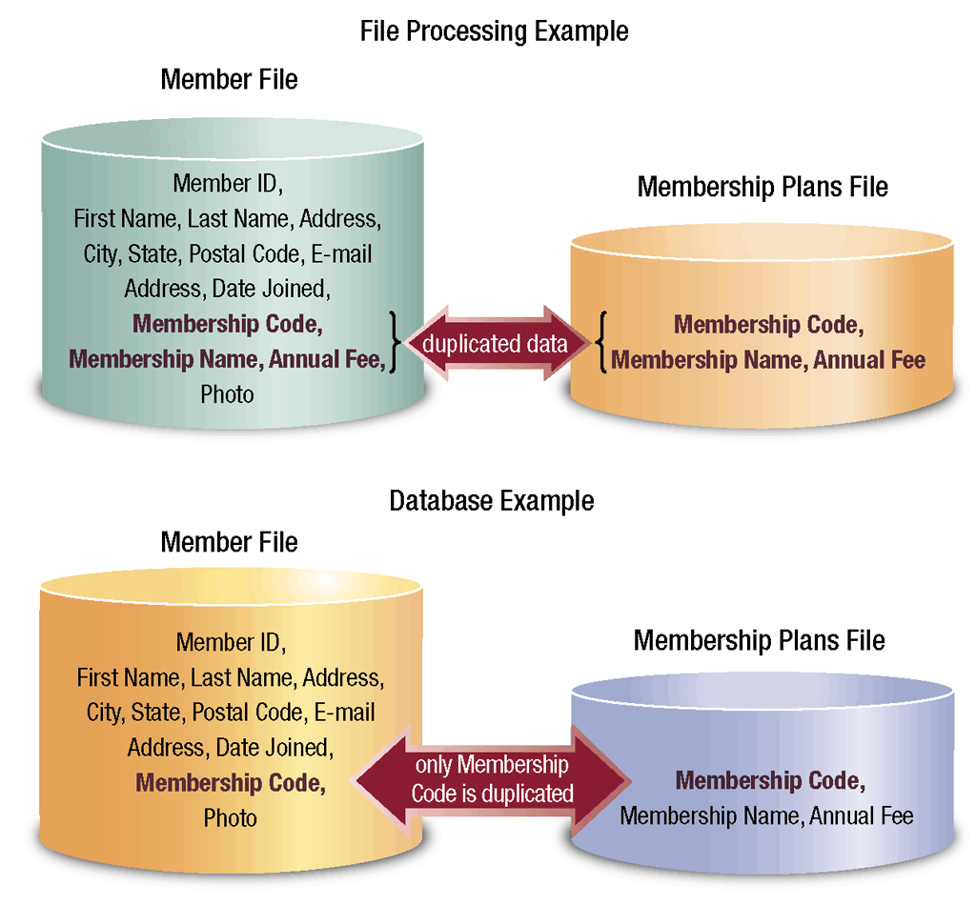
File Processing Versus Databases
How do a database application and a file processing application differ in the way they store data?
p. 525 Fig. 10-10
Next

Slide 22
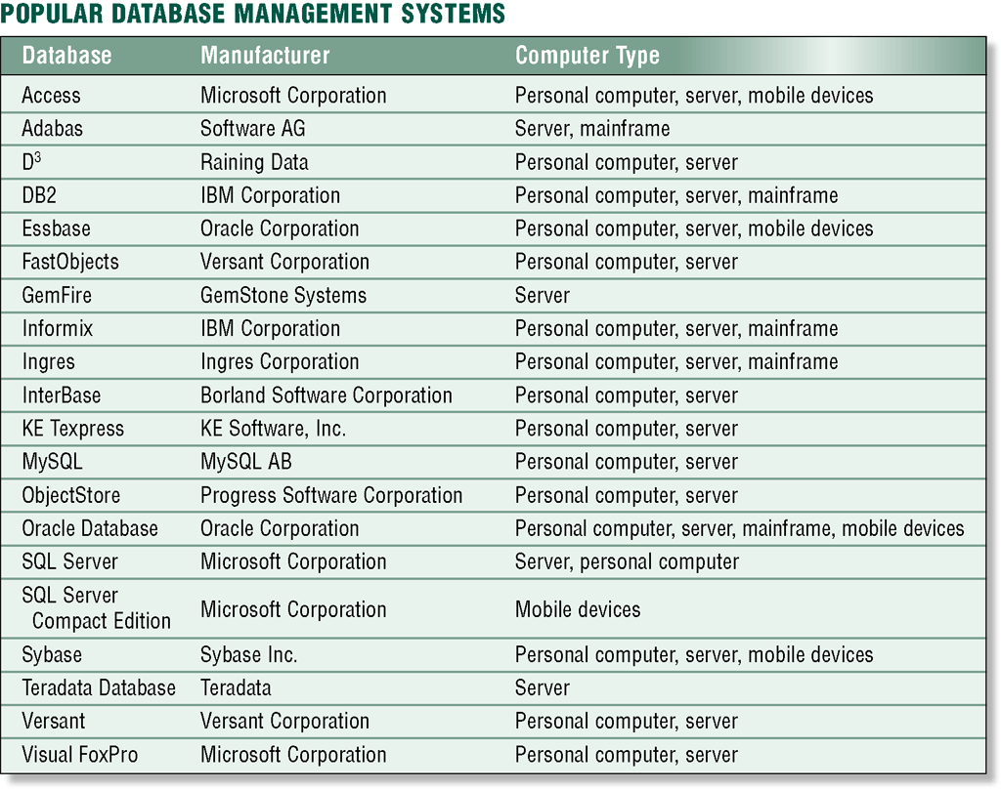
Database Management Systems
What are popular database management systems (DBMSs)?
Click to view Web Link, click Chapter 10, Click Web Link from left navigation, then click Teradata below Chapter 10
p. 526 Fig. 10-11
Next

Slide 23
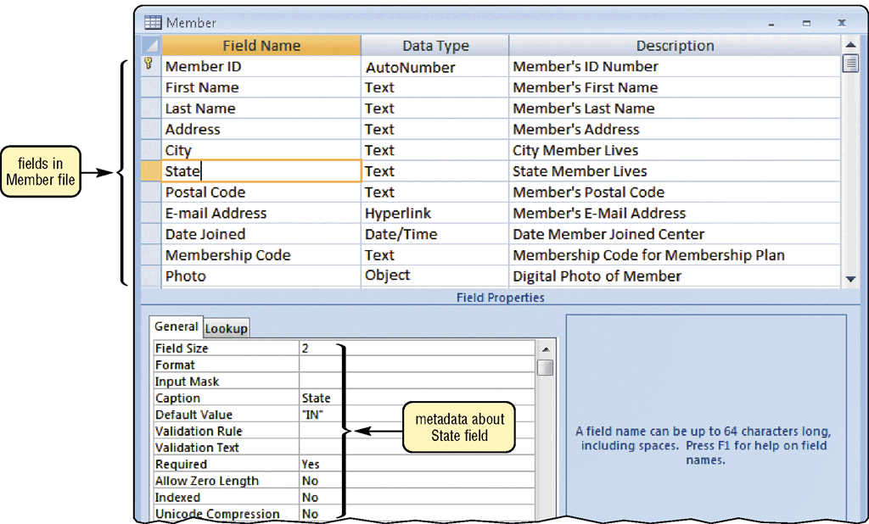
Database Management Systems
What is a data dictionary?
Contains data about each file in database and each field within those files
p. 527 Fig. 10-12
Next

Slide 24
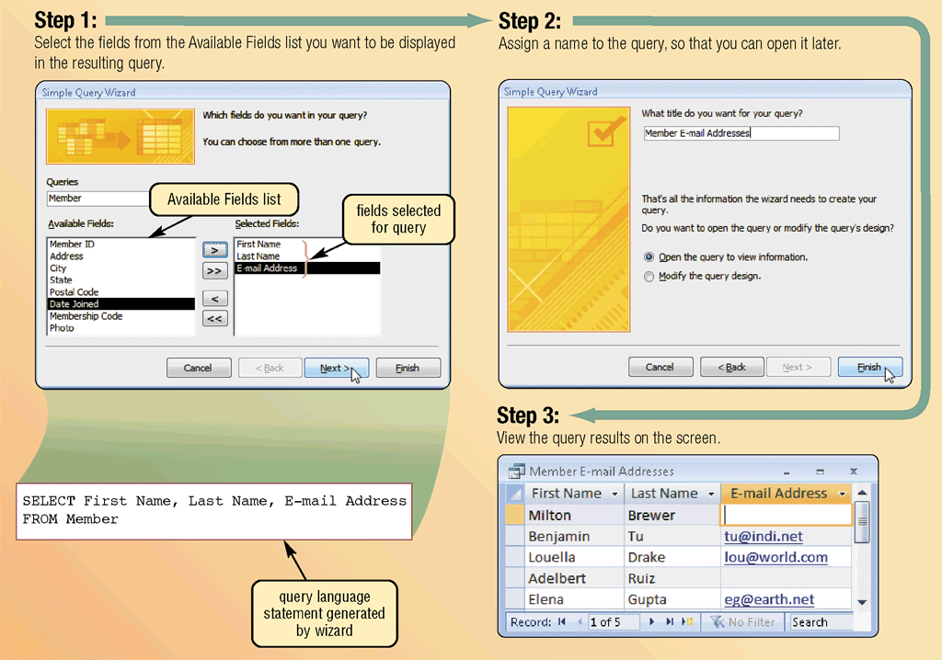
Database Management Systems
What is a query?
Request for specific data from a database
Query language consists of simple, English-like statements that allow users to specify data to display, print, or store
Click to view Web Link, click Chapter 10, Click Web Link from left navigation, then click Query below Chapter 10
p. 528 - 529 Fig. 10-13
Next

Slide 25
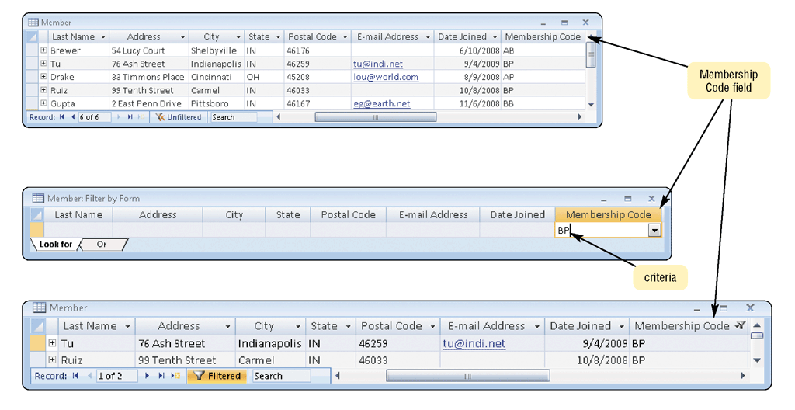
Database Management Systems
What is a query by example (QBE)?
Program retrieves records that match criteria entered in form fields
Has a graphical user interface that assists users with retrieving data
p. 528 - 529 Fig. 10-14
Next

Slide 26
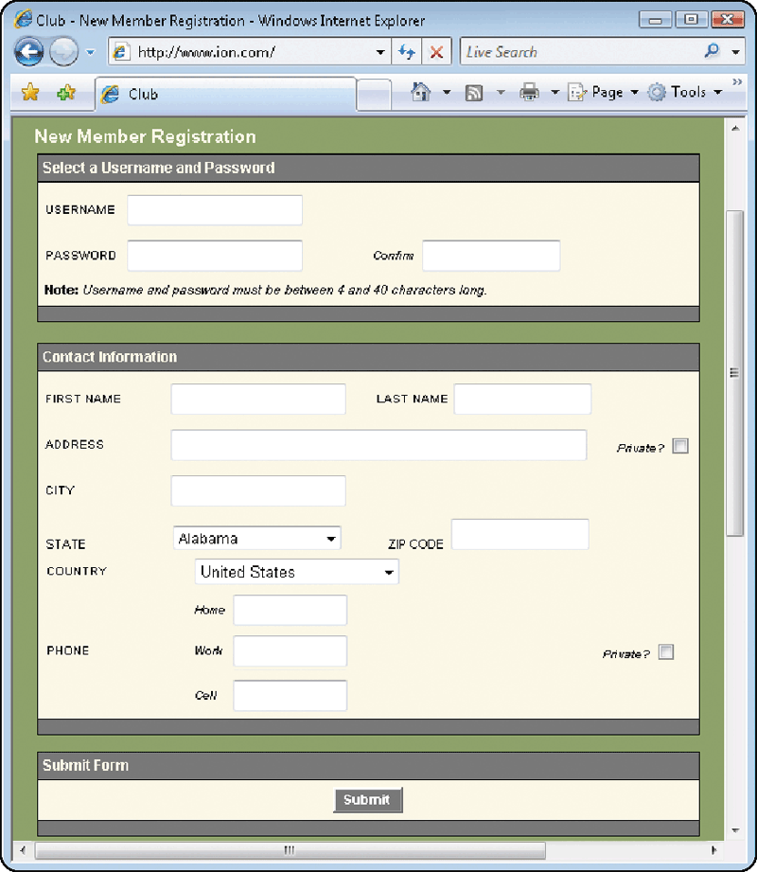
Database Management Systems
What is a form?
Window on screen that provides areas for entering or changing data in database
Used to retrieve and maintain data in a database
Form that sends data across network or Internet is called e-form, short for electronic form
p. 530 Fig. 10-15
Next

Slide 27
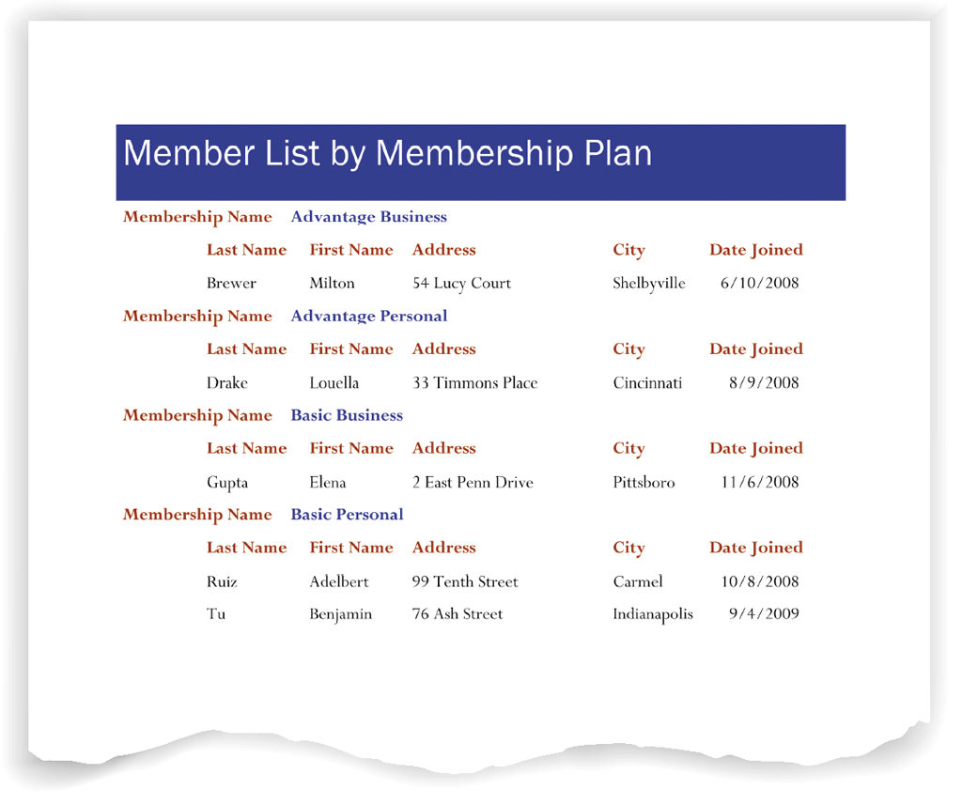
Database Management Systems
What is a report generator?
Allows user to design a report on screen, retrieve data into report design, then display or print reports
Also called report writer
p. 530 Fig. 10-16
Next

Slide 28
Database Management Systems
What is data security?
Access privileges define activities that specific user or group of users can perform
DBMS provides means to ensure only authorized users can access data
Read-only privileges -
user can view data, but cannot change it
Full-update privileges -user can view and change data
p. 530 - 531
Next

Slide 29
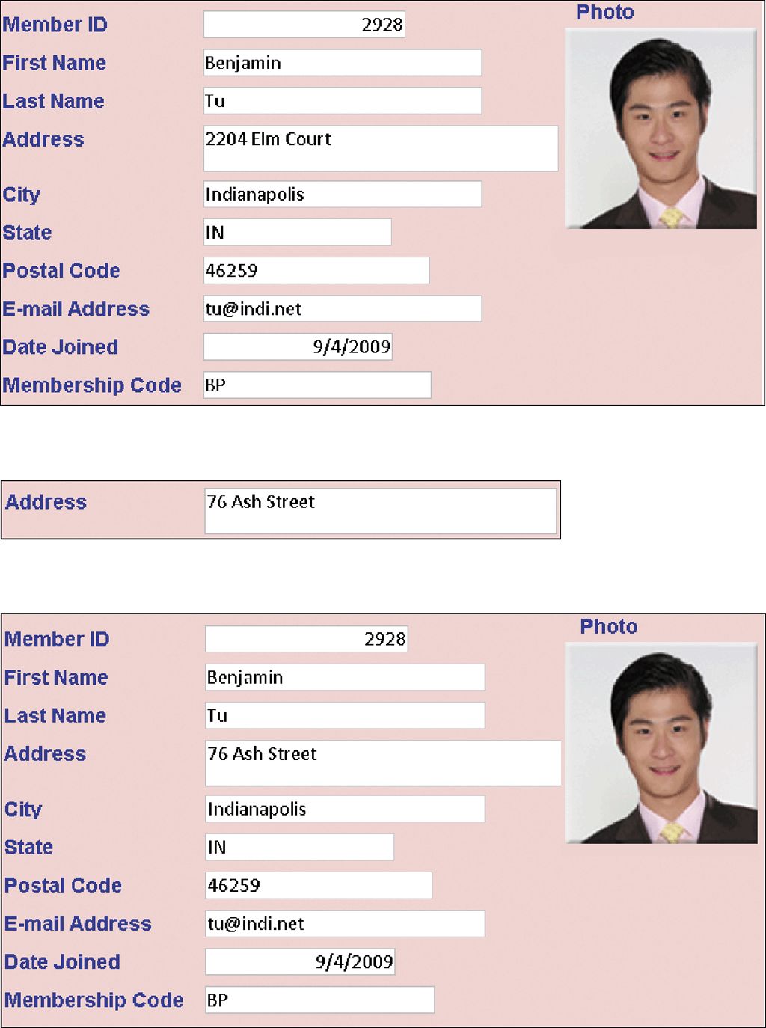
Database Management Systems
What are backup and log?
Backup is a copy of the entire database
Log is a listing of activities that change database contents
DBMS places three items in log: before image, actual change, and after image
p. 531 Fig. 10-17
Next

Slide 30

Database Management Systems
Video: How A Photo Sharing Site Keeps its Data
CLICK TO START
Next

Slide 31
Database Management Systems
What is a recovery utility?
Uses logs and/or backups to restore database when it is damaged or destroyed
Rollforward— DBMS uses log to re-enter changes made to data-base since last save or backup
Also called forward recovery
Rollback— DBMS uses log to undo any changes made to database during a certain period of time
Also called backward recovery
Click to view Web Link, click Chapter 10, Click Web Link from left navigation, then click Continuous Backup below Chapter 10
p. 531 - 532
Next

Slide 32
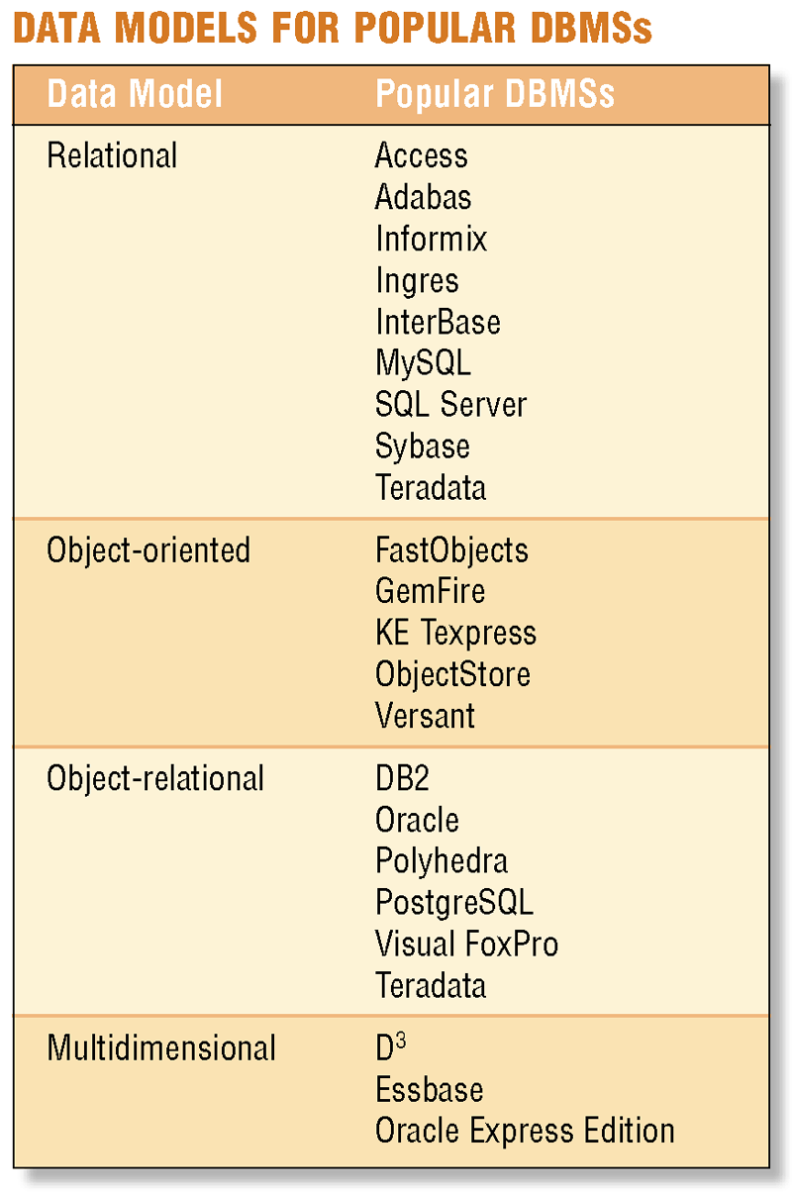
Relational, Object-Oriented, and Multidimensional Databases
What is a data model?
Rules and standards that define how database organizes data
Defines how users view organization of data
Four popular data models
Relational
Object-oriented
Object-relational
Multidimensional
p. 532 Fig. 10-18
Next

Slide 33
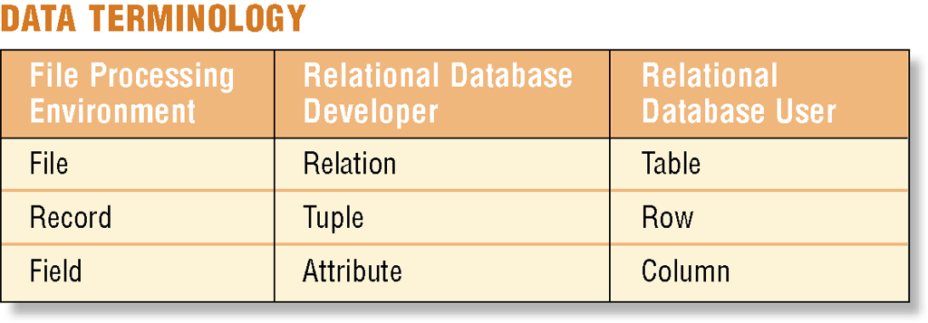
Relational, Object-Oriented, and Multidimensional Databases
What is a relational database?
Stores data in tables that consist of rows and columns
Each row has primary key
Each column has unique name
Stores data relationships
Uses specialized terminology
Click to view Web Link, click Chapter 10, Click Web Link from left navigation, then click Relational Databases below Chapter 10
p. 533 Fig. 10-19
Next

Slide 34
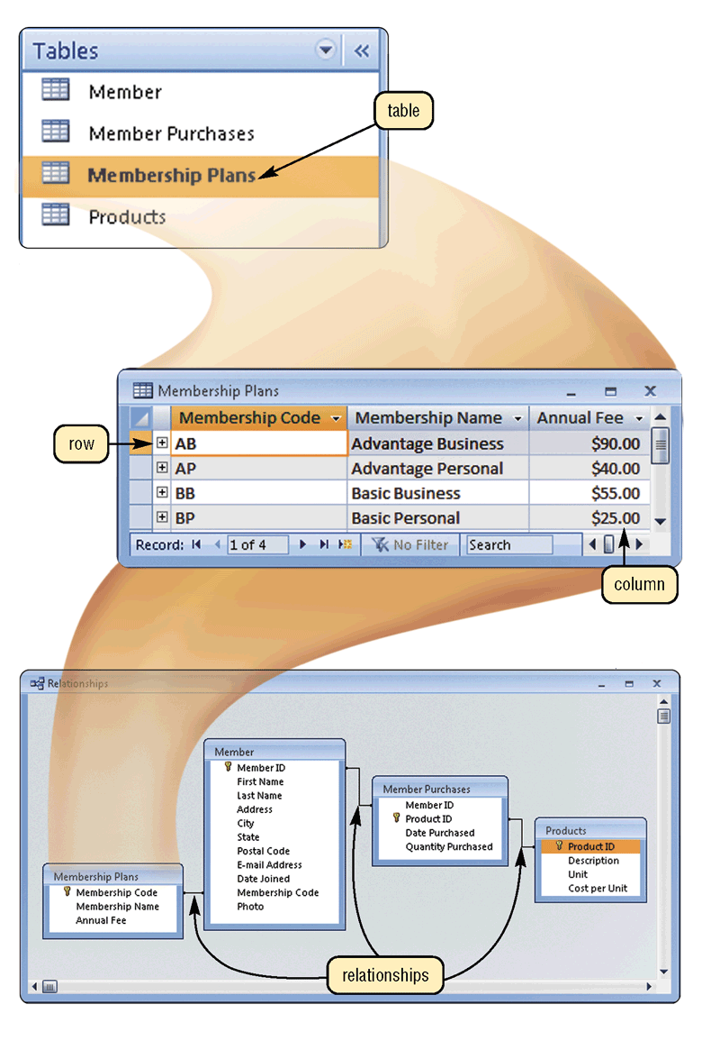
Relational, Object-Oriented, and Multidimensional Databases
What is a relationship?
Connection within data
p. 533 Fig. 10-20
Next

Slide 35
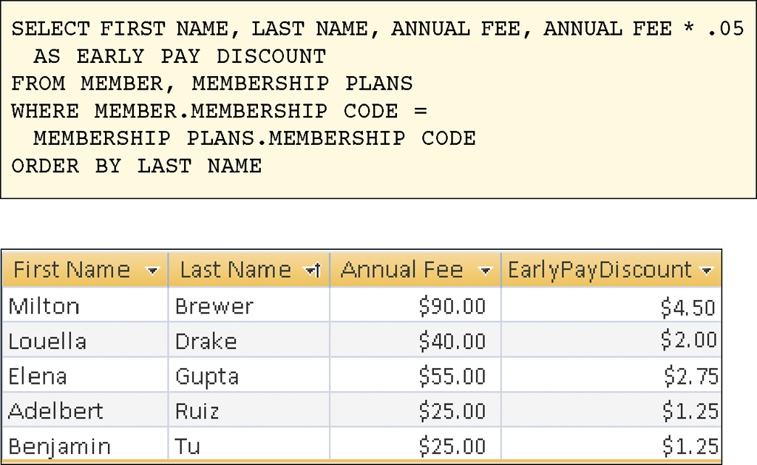
Relational, Object-Oriented, and Multidimensional Databases
What is Structured Query Language (SQL)?
Allows you to manage, update, and retrieve data
Has special keywords and rules included in SQL statements
Click to view Web Link, click Chapter 10, Click Web Link from left navigation, then click SQL below Chapter 10
p. 534 Fig. 10-21
Next

Slide 36
Relational, Object-Oriented, and Multidimensional Databases
What is an object-oriented database (OODB)?
Object is item that contains data, as well as actions that read or process data
Stores data in objects
Can store more types of data
Can access data faster
Programmers can reuse objects
Advantages
Often uses object query language (OQL)
Click to view Web Link, click Chapter 10, Click Web Link from left navigation, then click Object-Oriented Databases below Chapter 10
p. 534 - 535
Next

Slide 37
Relational, Object-Oriented, and Multidimensional Databases
What are examples of applications appropriate for an object-oriented database?
Multimedia databases
Groupware databases
Store images, audio clips, and/or video clips
Store documents such as schedules, calendars, manuals, memos, and reports
Computer-aided design (CAD) databases
Hypertext databases
Store data about engineering, architectural, and scientific designs
Contain text links to other documents
Web databases
Link to e-form on Web page
p. 534
Next

Slide 38
Relational, Object-Oriented, and Multidimensional Databases
What is a multidimensional database?
Stores data in dimensions
Multiple dimensions, also called hypercube, allow users to analyze any view of data
Can consolidate data much faster than relational database
Click to view Web Link, click Chapter 10, Click Web Link from left navigation, then click Multidimensional Databases below Chapter 10
p. 535
Next

Slide 39
Relational, Object-Oriented, and Multidimensional Databases
What is a data warehouse?
Huge database system that stores and manages data required to analyze historical and current transactions
Quick and efficient way to access large amounts of data
Often uses a process called data mining to find patterns and relationships among data
Uses multidimensional databases
Data mart is smaller version of data warehouse
Click to view Web Link, click Chapter 10, Click Web Link from left navigation, then click Data Warehouses below Chapter 10
p. 536
Next

Slide 40
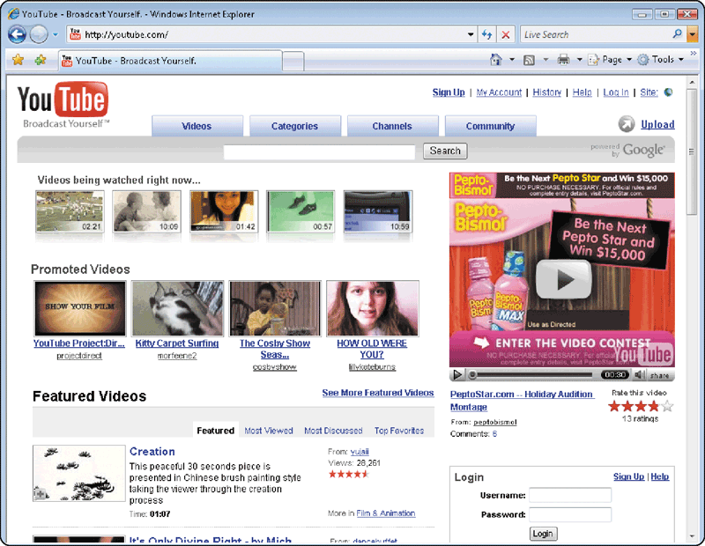
Web Databases
What is a Web database?
Database you access through the Web by filling in a form on a Web page
Usually resides on a database server, a computer that stores and provides access to a database
p. 536 - 537 Fig. 10-23
Next

Slide 41
Database Administration
What are guidelines for developing a database?
1. Determine the purpose of the database
2. Design the tables
3. Design the records and fields for each table
Design tables on paper first
Each table should contain data about one subject
Be sure every record has a unique primary key
Use separate fields for logically distinct items
Do not create fields for information that can be derived from entries in other fields
Allow enough space for each field
Set default values for frequently entered data
4. Determine the relationships among the tables or files
Click to view Web Link, click Chapter 10, Click Web Link from left navigation, then click Database Design Guidelines below Chapter 10
p. 537 Fig. 10-24
Next

Slide 42
Database Administration
What is the role of the database analyst and administrator?
Database analyst (DA)
Database administrator (DBA)
Focuses on meaning and usage of data
Decides proper placement of fields, defines relationships, and identifies users’ access privileges
Creates and maintains data dictionary, manages database security, monitors database performance, and checks backup and recovery procedures
Click to view Web Link, click Chapter 10,
Click Web Link from left navigation, then click Database Administrators below
Chapter 10
p. 538
Next

Slide 43
Summary of Database Management
How data and information are valuable assets to an organization
Advantages of organizing data in a database
Methods for maintaining high-quality data
Various types of databases
Assessing the quality of valuable information
Role of the database analysts and administrators
Chapter 10 Complete

